Slide 1
Focus of Presentation
Demolition of Heritage Properties
Effects on Iron Horse Trail
Effects on Part V Designated Property at 45 Mill
Indigenous Heritage
Notes:
I am here as a resident of Victoria Park. My background is in development and social change and I taught these subjects for nearly 30 years
I and my wife own a heritage property and we are quite concerned about how to preserve it

Slide 2
Background on 25 Mill Street
In 2010 staff recommendation listing 25 Mill on the Heritage Register
The owners (Polocorp) did not support listing of 25 Mill Street, saying that they planned to redevelop their property
An owner’s intention is not accepted as a criterion for the heritage value of a property under Regulation 09/06
Heritage value hinges on any of design, associative and/or historical value
Notes:
My first concern is the demolition of heritage properties
19 and 25 Mill were submitted for listing on the heritage register in 2010
Owners objected at HK meeting, indicated that they had plans for the property
Recommended by staff but rejected in 2010 by Council
Mr. Mike Puopolo, Polocorp Inc., attended in support of Heritage Kitchener's recommendation to not list 19 Mill Street and to ask that Council not support Heritage Kitchener's recommendation to list 25 Mill Street. He advised that the company is a strong supporter of heritage development, citing examples of past and current developments that they have been involved with. It was noted that the company has acquired approximately 1. 5 acres of land, including 19 and 25 Mill Street, with the intention of future redevelopment. Mr. Puopolo offered the following reasons in support of not listing 25 Mill Street on the MHR: the property is not located in the Victoria Park Heritage Conservation District; the exterior is in medium condition and the interior walls /floors have been redone; the proposed redevelopment is in keeping with the intent of the Kitchener Growth Management Plan and complies with the Zoning By-law; 25 Mill Street is an "orphan" building with surrounding buildings having no significant architectural or historical significance, resulting in a lack of continuity in the streetscape; and listing would hinder redevelopment as 25 Mill Street is central to the land assembly.
Reg. 09/06 indicates that the property has to have design, associative or historical value
25 Mill Street has all three
Victoria Park is itself “considered unique among Kitchener neighbourhoods, in part because the neighbourhood features a traditional pattern of nineteenth century urban development, with a mixture of factories, factory owner’s houses and worker’s housing located in close proximity to each other.

Slide 3
Ontario Heritage Act, Regulation 09/06
This regulation defines the criteria for heritage value
1. The property has design value or physical value
2. The property has historical value or associative value
3. The property has contextual value
Notes:
1.The property has design value or physical value because it is a rare, unique, representative or early example of a style, has craftsmanship or artistic merit, or
2. The property has historical value or associative value because it has direct associations with a theme, event, belief, person, activity, organization or institution that is significant to a community or has information that contributes to an understanding of a community or culture
3. The property has contextual value because it supports the character of an area, or is physically, functionally, visually or historically linked to its surroundings

Slide 4
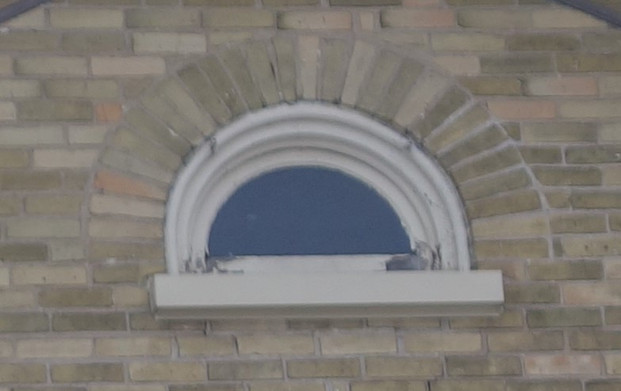
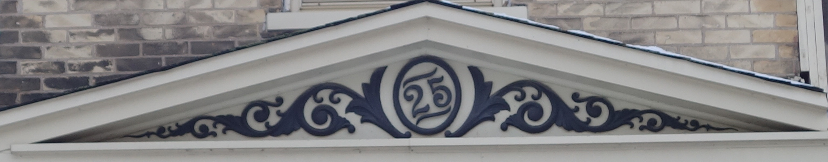
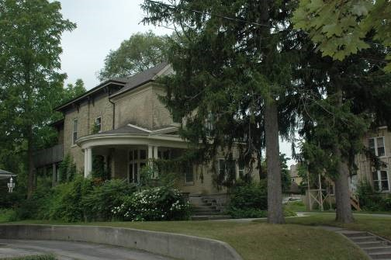
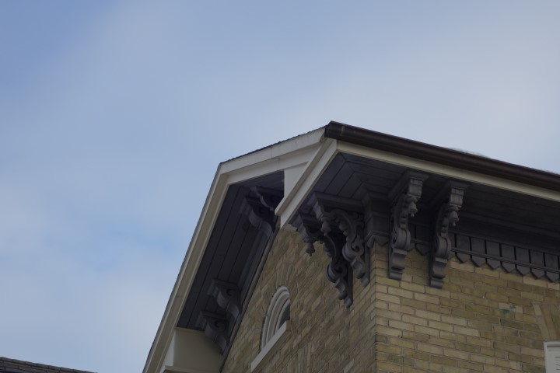
Rare Features on 25 Mill Street
Frieze over entrance
Lunette Window
Paired Cornice Brackets and decorative fascia
Circular Verandah
Notes:
The circular verandah is rare in the region
Compare circular verandahs in London, Rednersville and Thunder Bay in http://www.ontarioarchitecture.com/

Slide 5
Background on 19 Mill Street
In 2010, heritage staff indicated that 19 Mill Street has design value and associative value since it contributes to the character of the street
Additional reasons to protect 19 Mill:
Property has historic value
Built by Moses Unger in 1897, a descendant of early settlers from Pennsylvania, a prominent wood and coal merchant throughout the region, having lived in Hespeler, Preston and Kitchener
19 Mill Street also borders on the Victoria Park Heritage Conservation District
Notes:
Heritage staff did believe that 19 Mill Street had design and associative value, but did not suggest it be listed
I would add that there are additional reasons for listing and for its preservation
The property has historic value as well, built by Moses Unger in 1897
Unger was a prominent wood and coal merchant, having lived in Hespeler, Preston and Kitchener
According to his death notice, he was a well known figure in the region
Unger: https://generations.regionofwaterloo.ca/getperson.php?personID=I3790&tree=generations#cite7

Slide 6
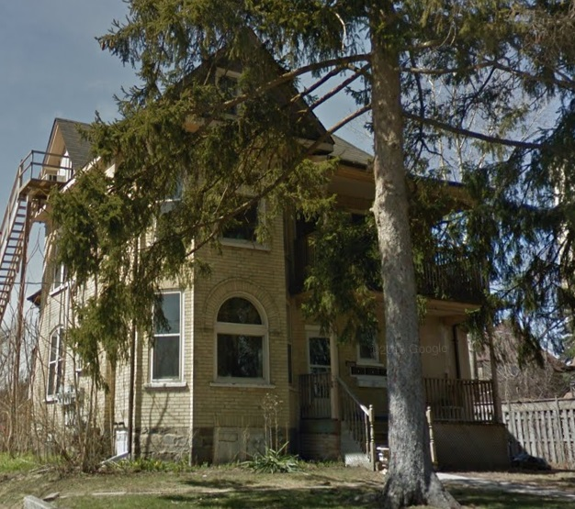
Heritage Attributes at 19 Mill
  Cross gabled roof
  Brackets
  1/1 hung windows
  Picture windows and transoms with brick voussoir
  Stained glass windows
  2 storey front verandah
  1 storey rear verandah

Slide 7
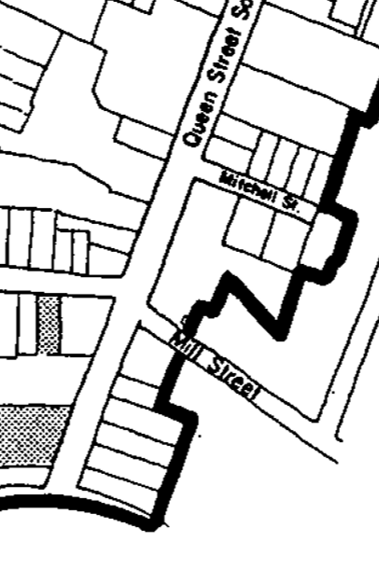
Victoria Park Heritage Conservation District
The boundary of the VPHCD did not include the
Mill Street properties…
Properties were built at a similar time and manner to many in the VPHCD
The architecture of 25 Mill Street is unique, not just interesting
There are no others like it in the region
Notes:
19 and 25 Mill were submitted for heritage designation in 2010
Owners objected at HK meeting, indicated that they had plans for the property
recommended by staff but rejected in 2010 by Council
Mr. Mike Puopolo, Polocorp Inc., attended in support of Heritage Kitchener's recommendation to not list 19 Mill Street and to ask that Council not support Heritage Kitchener's recommendation to list 25 Mill Street. He advised that the company is a strong supporter of heritage development, citing examples of past and current developments that they have been involved with. It was noted that the company has acquired approximately 1. 5 acres of land, including 19 and 25 Mill Street, with the intention of future redevelopment. Mr. Puopolo offered the following reasons in support of not listing 25 Mill Street on the MHR: the property is not located in the Victoria Park Heritage Conservation District; the exterior is in medium condition and the interior walls /floors have been redone; the proposed redevelopment is in keeping with the intent of the Kitchener Growth Management Plan and complies with the Zoning By-law; 25 Mill Street is an "orphan" building with surrounding buildings having no significant architectural or historical significance, resulting in a lack of continuity in the streetscape; and listing would hinder redevelopment as 25 Mill Street is central to the land assembly.
Reg. 09/06 indicates that the property has to have design, associative or historical value
25 Mill Street has all three

Slide 8
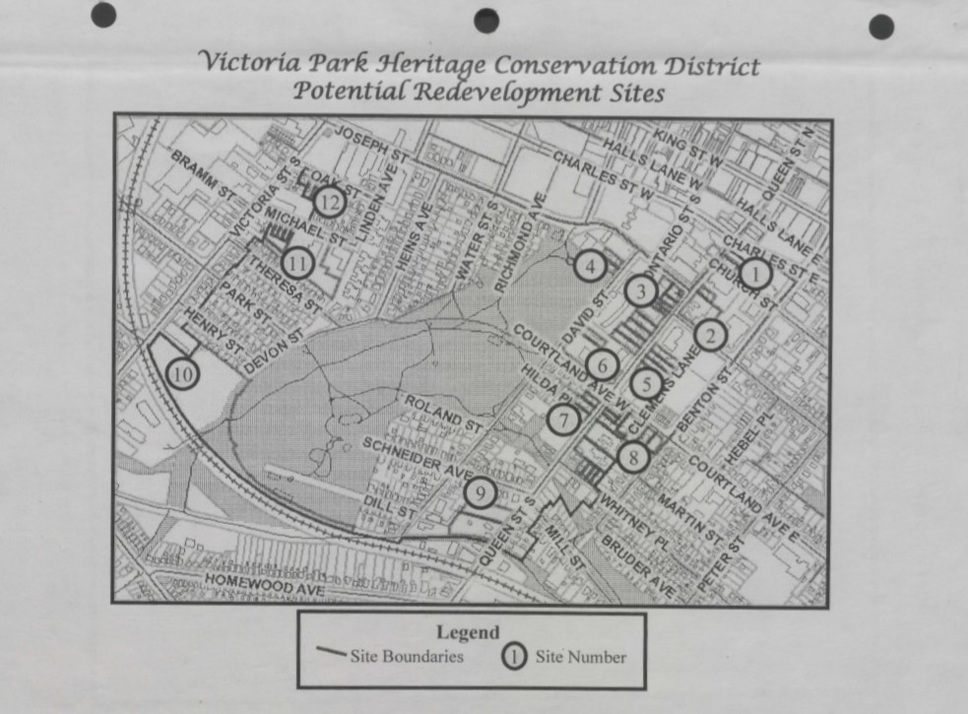
Notes:
Mill Street was not identified as a potential redevelopment site in the VPHCD Plan

Slide 9
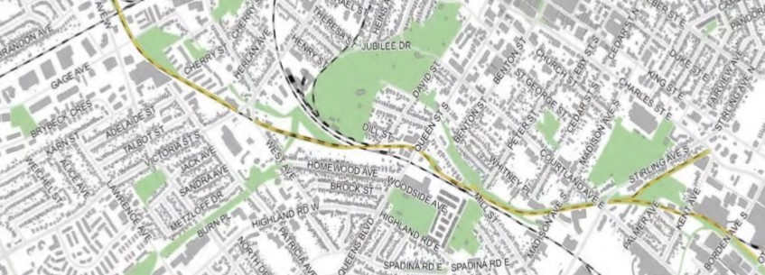
Iron Horse Trail
Identified as a Cultural Heritage Landscape (CHL) in 2014
Connects downtown Kitchener to uptown Waterloo
Borders on three other CHLs and two parks
Provides a scenic and historic route linking the two cities
Notes:
Secondly, the development will significantly impact the Iron Horse Trail, a Cultural Heritage Landscape
The City has made a considerable capital investment in telling the story of pioneer settlement in the vicinity of the Pioneer Tower, Schneider House, industrial heritage through public art, and the history of First Nations at the Huron Natural Area. Such have a huge impact on our sense of community
The next step is underway – to include it in the Official Plan

Slide 10
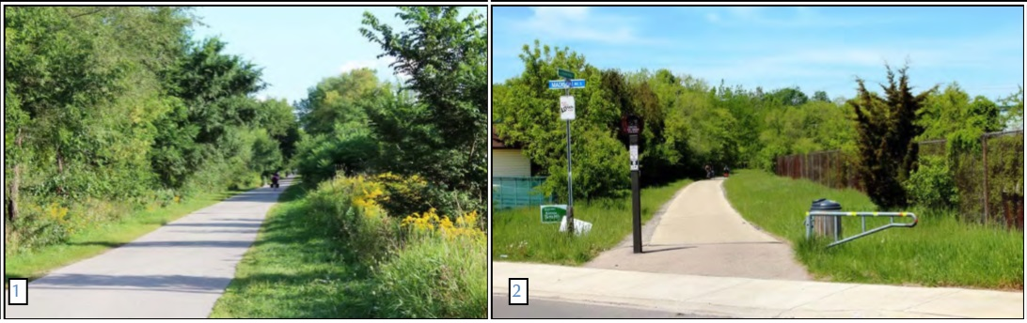
A Trail is:
A track made by passage especially through a wilderness - Merriam Webster
A path through a countryside, mountain, or forest area - Cambridge
These refer to nature; a high rise building is the antithesis of nature
Notes:
Let us pause to think: What is a trail?
A track made by passage especially through a wilderness - Merriam Webster
A path through a countryside, mountain, or forest area - Cambridge
Building next to the trail destroys that sense of nature and the history of Kitchener
All of these refer to nature; a high rise building is the antithesis of nature

Slide 11
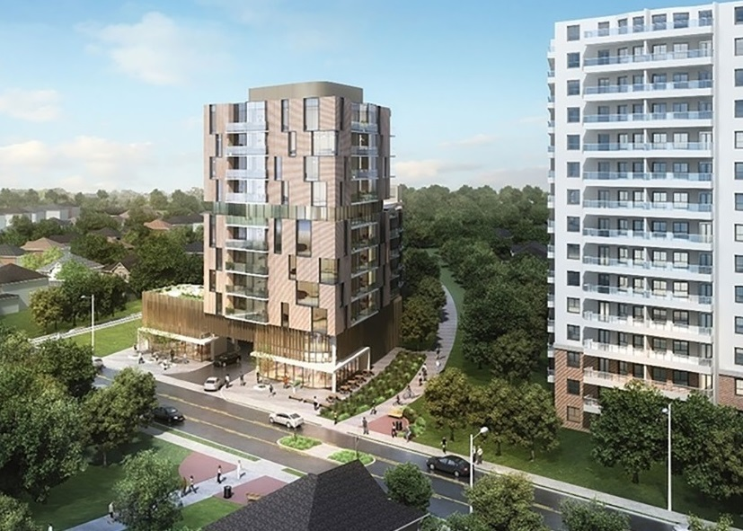
600 Queen as Proposed by Architects
If you look at this image, you will see a wide swath of green on the right of the trail
Image from aba Architects, Inc
Notes:
What is development doing to our trail?
If you look at this image, you will see a wide swath of green on the right of the trail

Slide 12
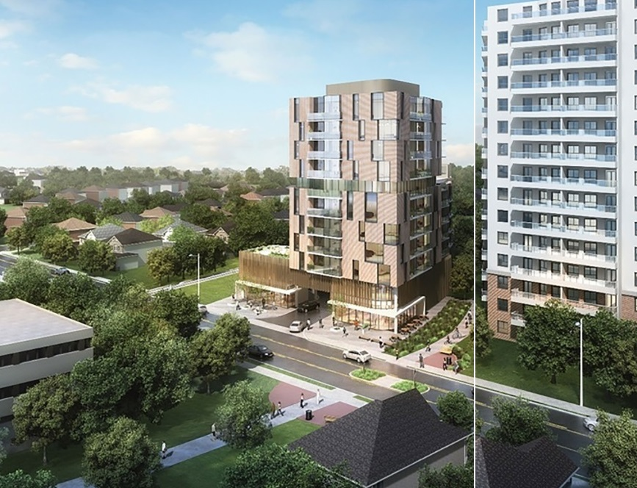
The Reality
Notes:
In fact, there is a fence about 1 metre from the path next to the Iron Horse Tower

Slide 13
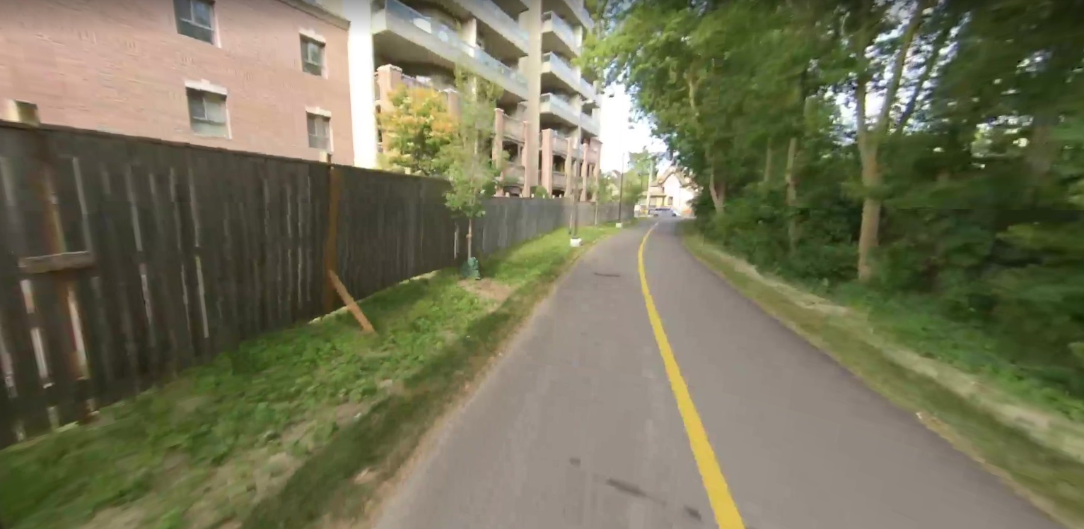
The Fence
Notes:
In fact, there is a fence about 1 metre from the path next to the Iron Horse Tower

Slide 14
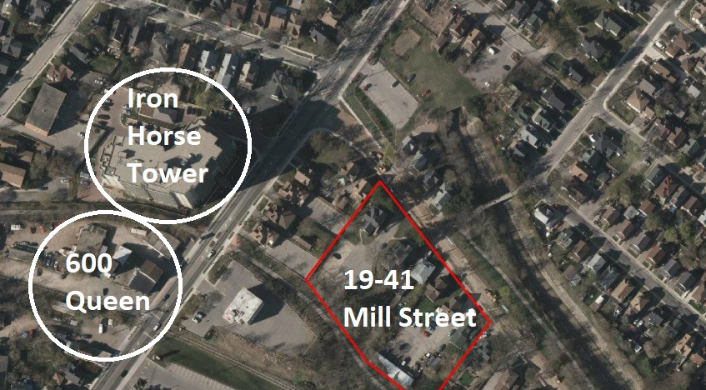
Three Towers within 200 Metres of Each Other

Slide 15
Mill Street High Rise and the Trail
A 13 metre distance from the building to the middle of the trail is proposed
What would this look like? Compare the trail at 460 Belmont Avenue
Notes:
A 13 metre distance from the middle of the trail to the edge of the building is proposed
However, there are similar developments along the trail at 460 Belmont Avenue

Slide 16
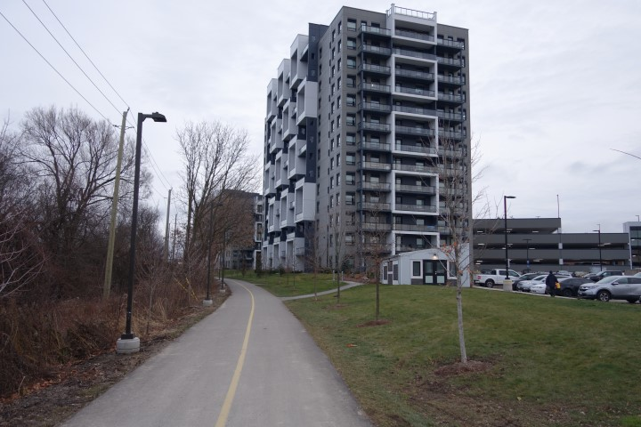

Slide 17
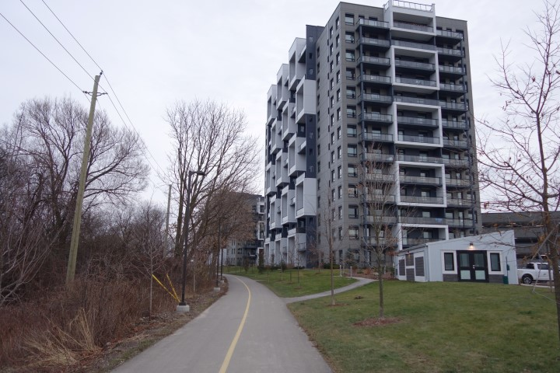

Slide 18
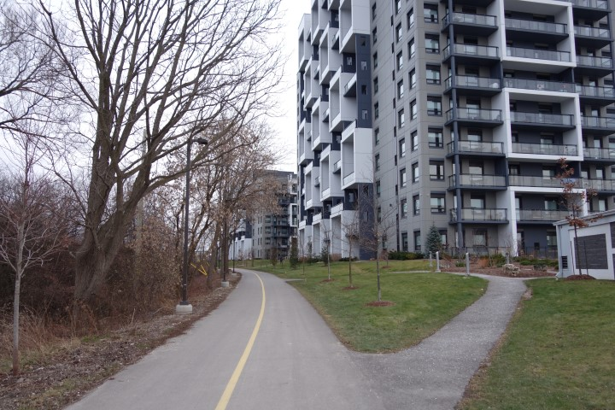

Slide 19
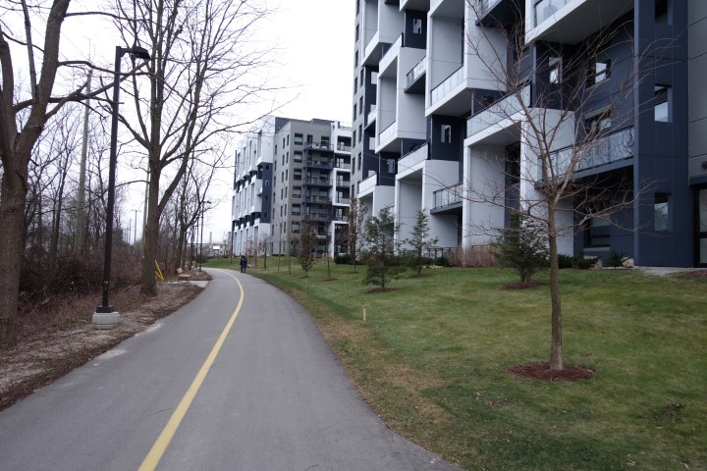

Slide 20
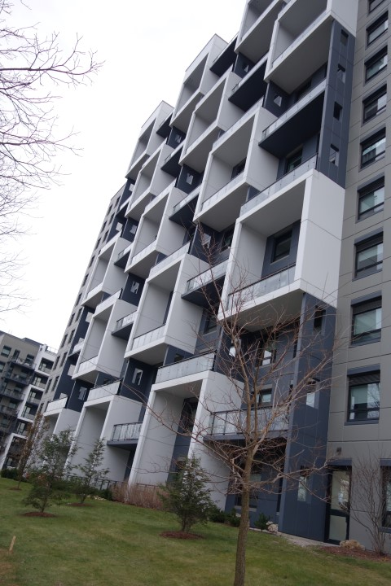

Slide 21
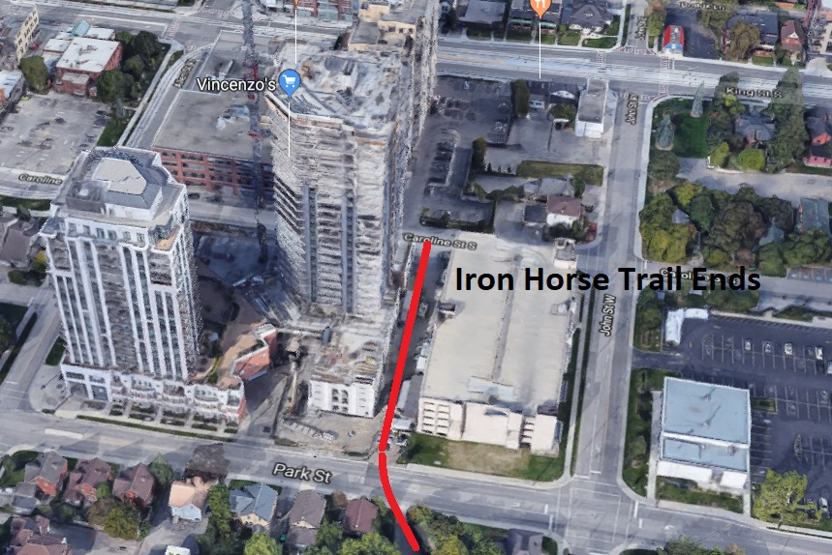
Notes:
Here is the Iron Horse Trail at the Waterloo end
Further development along the trails will see the end of a trail… but we will still have a path surrounded by buildings

Slide 22
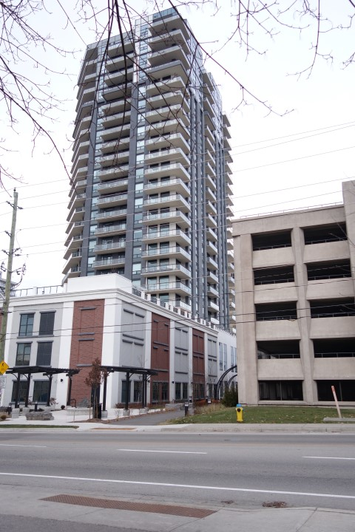
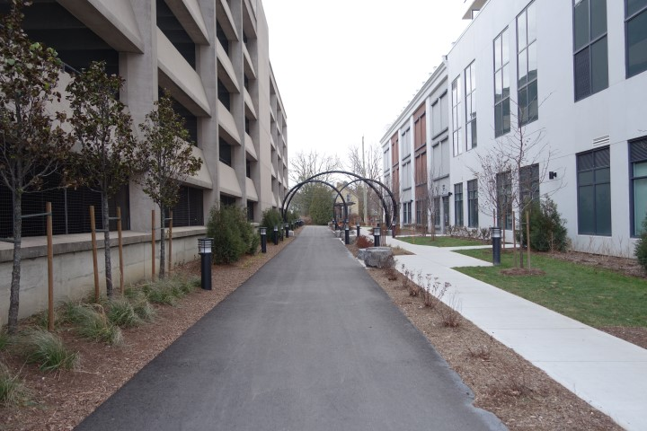
Do we want this?
Notes:
Here is the Iron Horse Trail at the Waterloo end
Further development along the trails will see the end of a trail… but we will still have a path surrounded by buildings

Slide 23
Or shall we follow the Provincial Policy Statement,
where it is stated that:
“Significant built heritage resources and significant cultural heritage landscapes shall be conserved.”

Slide 24
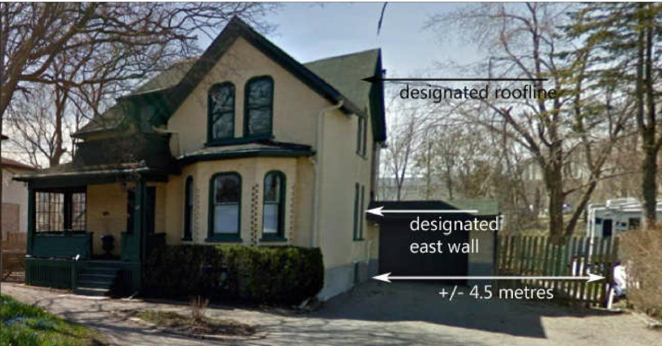
Designated Part IV Home at 45 Mill
Notes:
Thirdly, I want to examine the Part IV property at 45 Mill Street

Slide 25
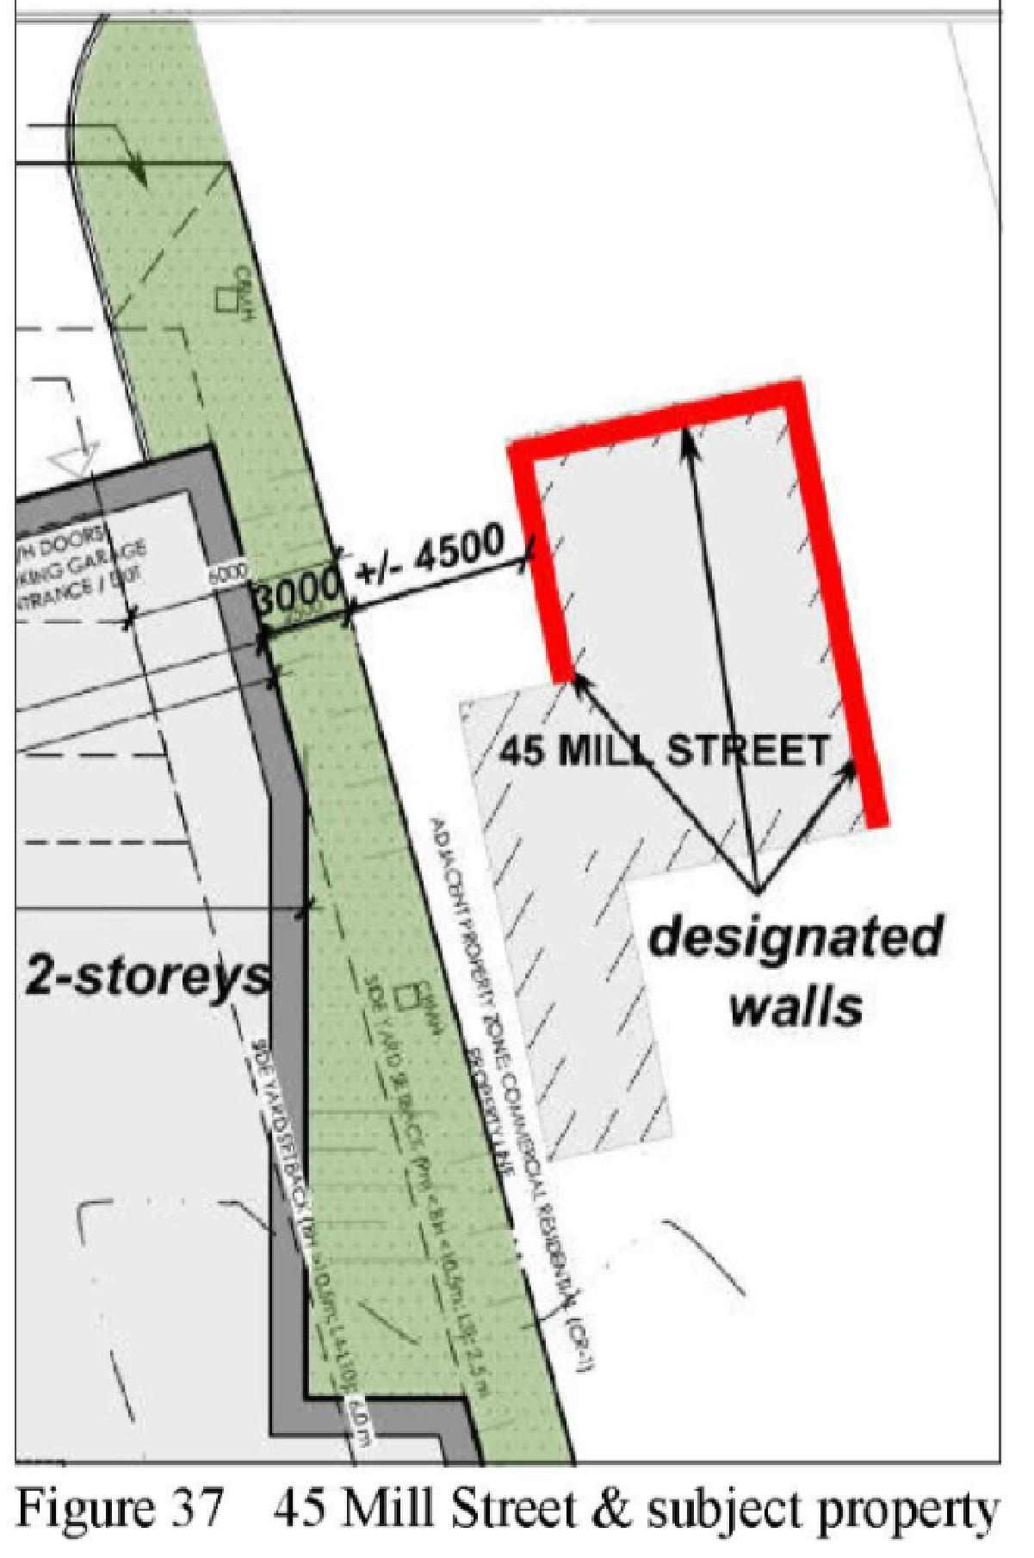
Plan View of Proposed High Rise Next to 45 Mill

Slide 26
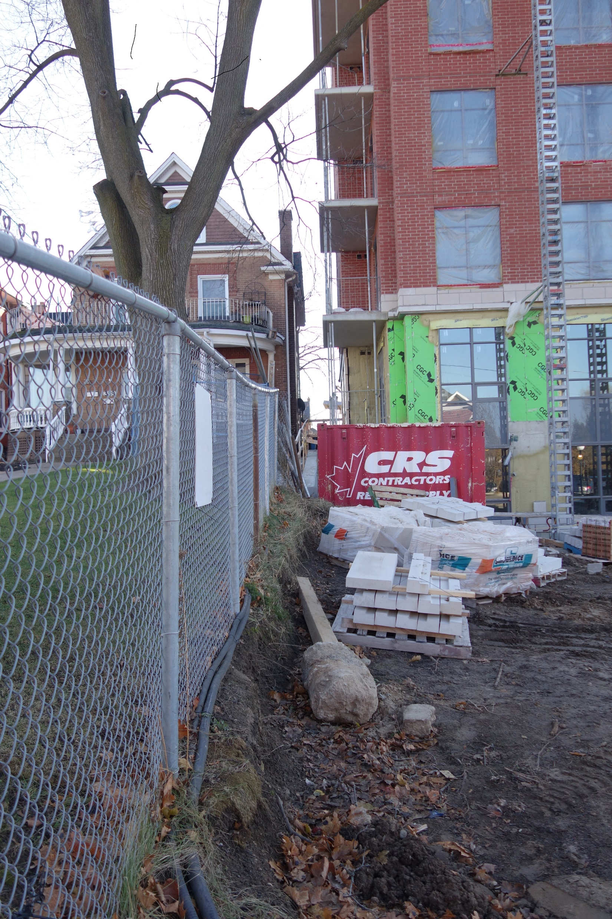
389 Queen Street Next to Barra Condos
Notes:
Polocorp sees no issue with a very small setback from adjacent properties

Slide 27
Official Plan Residential Policy states:
Multiple residential developments shall have designs that emphasize:
Compatible built form with respect to massing, scale, and design
Relationship of housing to adjacent buildings, streets, and exterior areas
Setback is meeting the minimum required 2.5 metres
45 Mill Street is approximately 7 metres tall
The proposed height next to 45 Mill is 12 metres tall
Notes:
However, the official plan has other policies about compatibility

Slide 28
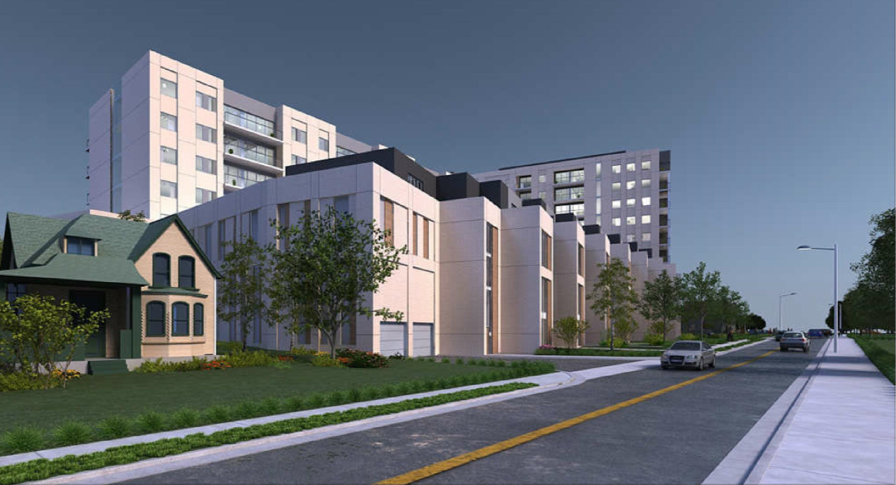
Conceptual Drawing Next to 45 Mill

Slide 29
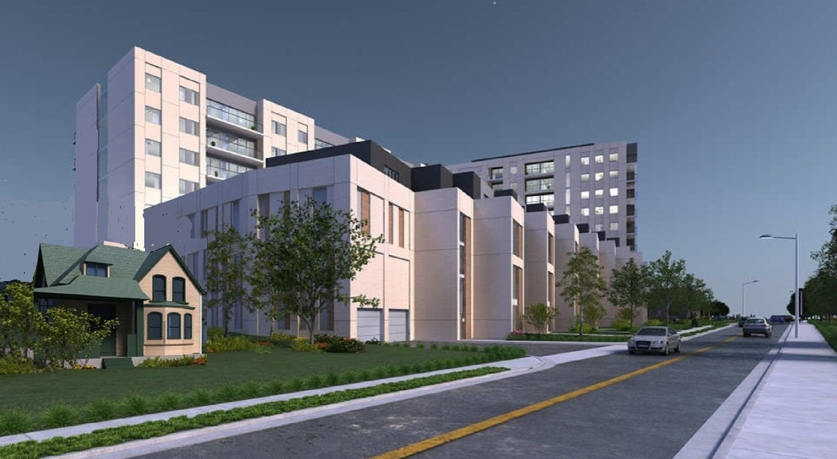
Is it actually more like this?

Slide 30
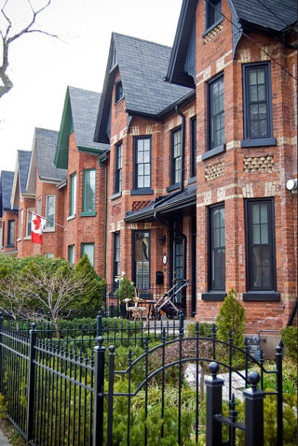
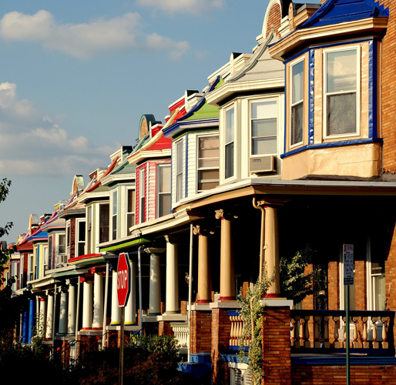
How about something more appropriate to the neighbourhood?

Slide 31
Summary
Keep these heritage homes, one of which is unique and has historic, contextual and associate value
Protect the Iron Horse Trail, a valuable cultural heritage landscape
Reduce the negative impact on the Mill Street heritage neighbourhood. The proposed building is incompatible in size and design
Change the Mill Street façade to reflect the heritage of the area
Notes:
Mill Street was built on an indigenous trail and was one of the principal routes into Kitchener from the south
Many reports of interactions between indigenous people and settlers, especially the residents of Schneider Haus
Hannes Schneider and his wife Catharine Haus Schneider: Their Descendants and Times 1534-1939
This is not surprising since the trail went from Doon, where a settlement of Haudenosaunee existed to around Strange Street, the location of another indigenous settlement

Slide 32
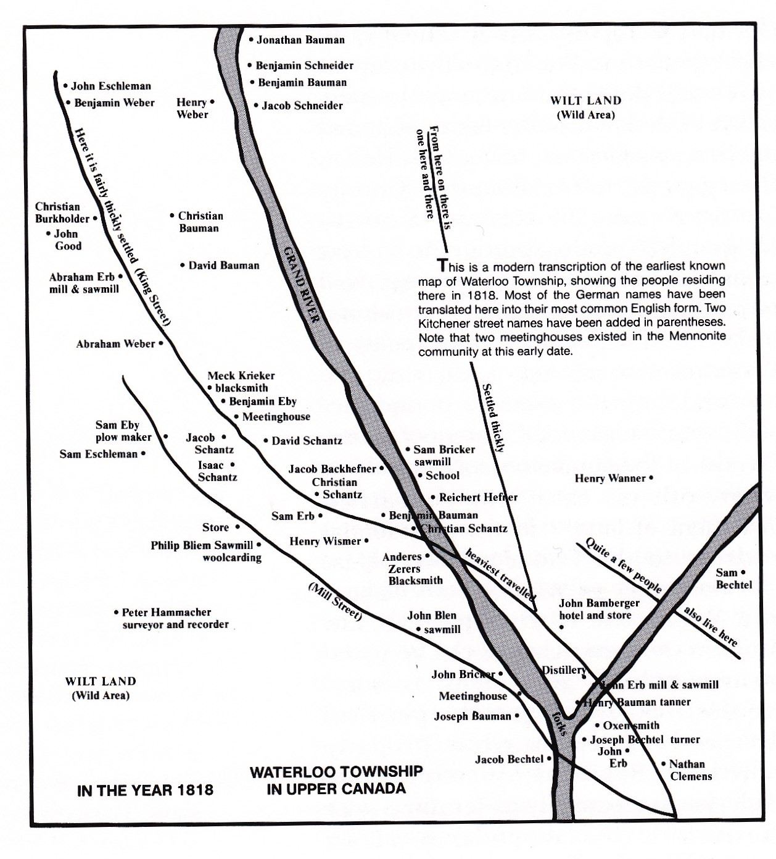
Mill Street in 1818
Notes:
Mill Street was the principal route into the city, so named for the many mills along what became Schneider Creek

Slide 33
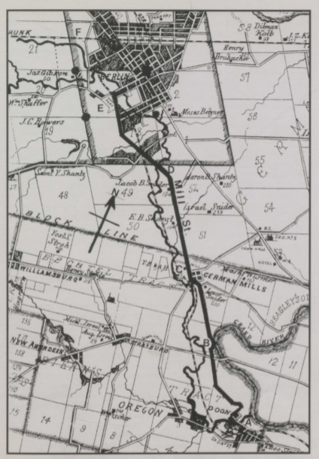
Parsell Map of 1881, with locations noted
Mill Street
Indigenous Trail
Grand River/Schneider Creek

Slide 34
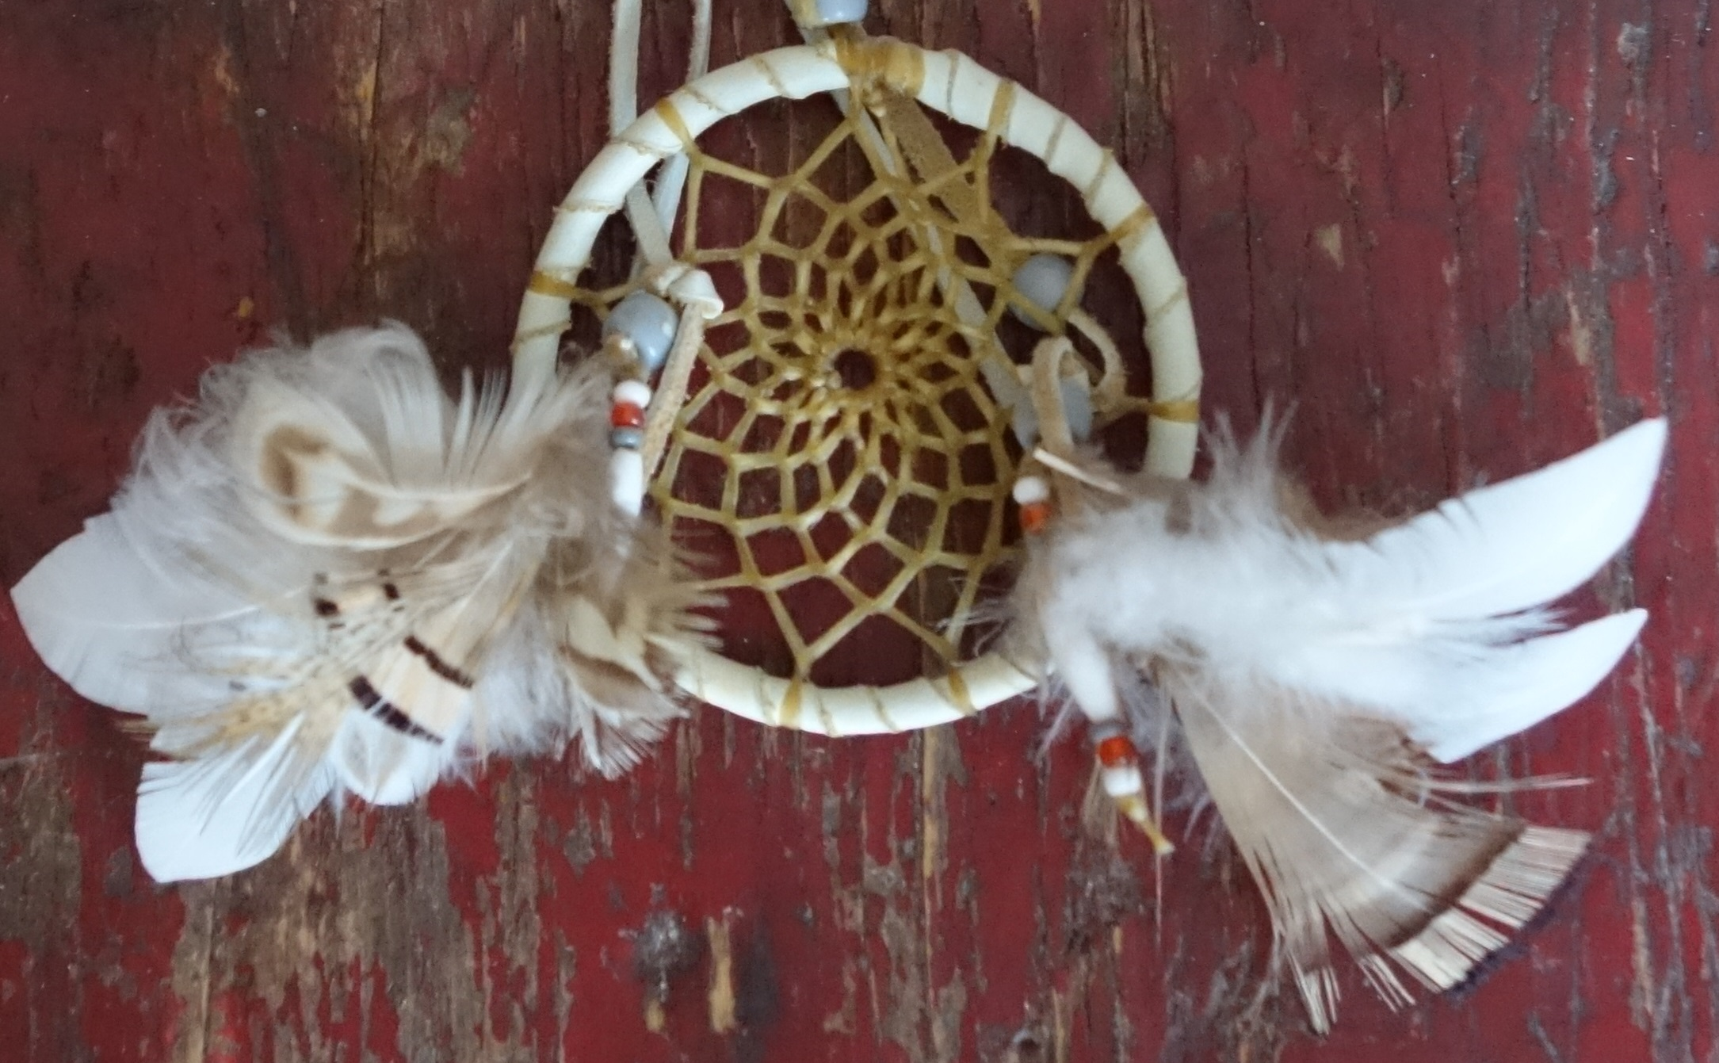
It is possible that there are archaeological resources on site, on the trail, or beside the trail.
The City’s study of Cultural Heritage Landscapes acknowledge the possibility of archaeological remains
Notes:
I hope that the current proposal will be re-examined and a thorough look at the way we are destroying our heritage in Kitchener
Once we destroy it, we cannot get it back

